Slide 1

GROUP 141 - FINAL YEAR PROJECT ORAL PRESENTATION
THE SIGNIFICANCE OF IMPACT FROM INTERNATIONAL CRUDE OIL PRICE ON CHINESE MACRO ECONOMY
Supervisor: Eric WONG
Presented by:
Xiang WEN (Gavin) 1430001100
Weizhen KONG (Kurt) 1430001037

Slide 2
1
INTRODUCTION
Statement of problem
Object of study
Literature review
Hypothesis

Slide 3
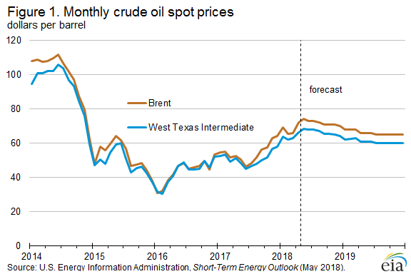
Statement of problem
Part One
Introduction
Crude oil：One of the crucial resources to the economy and the development of a country
A number of international events (Politic & Economy, etc)
West Texas Intermediate (WTI) - NYMEX
Brent Crude - IPE
Dubai Crude – SGX
Western Canadian Select (WSC)
The fluctuation of crude oil price
Confidence of investors changes dramatically
Notes:
NYMEX – The New York Mercantile Exchange
IPE - The International Petroleum Exchange
SGX – The Singapore Exchange

Slide 4





Statement of problem
Part One
Introduction
Factors driving the trend of the oil price:
1. Organization of Petroleum Exporting Countries (OPEC)
2. The innovation of shale oil exploiting technology (U.S.)
3. Substantial reserves of shale oil resources found in China
4. Demand for crude oil in Asia
……
“the concentration of organic carbon in Chinese oil shale is high” &
“resources in China are abundant with a high potential for exploitation” (Liu, et al., 2017)

Slide 5
Literature review
Part One
Introduction
1. Macroeconomic responses to the oil price fluctuation
Du, He and Wei (2010): influence of oil price shock is increasing, resulting from the dependence on oil import and consumption
Omojolaibi (2014): Nigeria case
Jbir and Zouari-Ghorbel (2008): Tunisian case
Rafiq, Sali and Bloch (2008): Thai economy case
Lorde, Jackman and Thomas (2009): impact of oil price in Trinidad and Tobago

Slide 6
Literature review
Part One
Introduction
2. Impacts of change in global energy market structure
Baumeister and Kilian (2016): confirm the influence of shale oil technology
Brune (2015): investigated the impact from shale oil to the market and U.S. economy

Slide 7
Literature review
Part One
Introduction
3. Asymmetric effects of oil prices in economic variables
Mohanty, Tawfeek and Bugshan (2012) used Auto-Regressive Distributed Lag model (ARDL) model to estimate the effect of oil price on state income in the United States
Mansor H. Ibrahim and Rusmawati Said (2017): oil price has positive impact on inflation in South Africa

Slide 8
Literature review
Part One
Introduction
4. Chinese researches on domestic economic responses to international oil prices
Liu and Jiang (2009): detected the impact on the variance of domestic product oil
Liu (2008): the fluctuations of oil prices have nonlinear and asymmetric effects on Chinese domestic output
Tilak Abeysinghe (2001): oil price effect on GDP growth are both direct and indirect
Li Z. and Li L. (2011) proved the response of domestic macro economy was lagged to the fluctuation of oil prices

Slide 9
Objective of the study
Part One
Introduction
To provide predictions on influencing significance of international oil price toward Chinese macroeconomy in better accuracy and make certain comparison among various relationships between crude oil price in global market and different economic indicators in respect of significance
The impact of oil prices toward gross national production and inflation are investigated and the mutual influences among the three variables are also tested

Slide 10
Statement of hypothesis
Part One
Introduction
1
The change of oil price will positively influence the sensitivity of change in GDP
2
The sensitivity of CPI change rate will positively influence the sensitivity of change in GDP
3
Previous rate of changes in GDP will have positive effect present rate of change in GDP

Slide 11
2
METHODOLOGY
Data source
Modelling
Data description

Slide 12
Data source
Part Two
Methodology
Variables
Daily Brent Oil Futures Prices
China Seasonal Gross Domestic Product
China Monthly Consumer Price Index
Time range
Quarterly data from 1995:1 to 2016:12
Secondary data from database of U.S. Energy Information Administration (EIA) and the National Bureau of Statistics of China official website
Notes:
the oil prices---- the Brent crude oil prices (since the Brent price plays a role of benchmark in two-third of trade volumes in international oil market and it is flexible in avoiding risk )
First of all let me introduce the methodology
There are three variables including 123, the first one is secondary data from database of us energy information administration, the other two variables are from …
The time range is from… to… and because the minimum unit of gdp and cpi is month,we transfer the daily brent oil price into monthly data by averaging them

Slide 13
Data description
Part Two
Methodology
Δy---change in GDP between one value and its former value
Δo---the differences between two adjacent data of oil prices
Δx---the differences between two adjacent data of CPI
Notes:
The variables are showed as … in the model, the … means the difference between two adjacent data

Slide 14
Modelling
Part Two
Methodology
The new concept that Hamilton (2003) created called [net oil price change] was used to eliminate the influence of exogenous factors like political factors
1
The framework of the analysis is to investigate the influence of change in oil prices (IV) to GDP (DV) with sensitivity of CPI (CV)
2
Sensitivity of CPI
Change of Crude Oil Price
Sensitivity of GDP
3
The change in crude oil price is assumed to impose influence on the sensitivity of GDP and the sensitivity of CPI is assumed to affect the IV-DV relation.
The formula is established to measure the mutual effects and former data effect by using the Autoregressive Distributed Lag Model (ARDL)
4
Notes:
As for the framework, because…, the other factors are eliminated from the model. ….

Slide 15
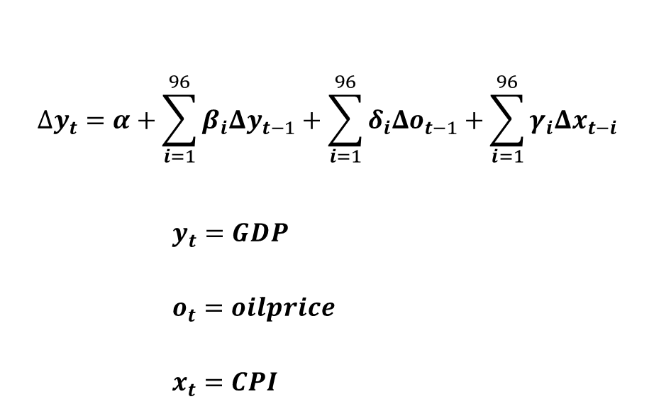
Modelling
Part Two
Methodology
$$∆y_{t}=α+\sum_{i=1}^{96}{β_{i}Δy_{t−1}+\sum_{i=1}^{96}{δ_{i}Δo_{t−1}+\sum_{i=1}^{96}{γ_{i}Δx_{t−i}}}}$$
$y_{t}=GDP$
$o_{t}=oilprice$
$x_{t}=CPI$
The change in GDP depends on its lagged data, the change in oil prices and the change in CPI during the previous quarters. All these three variables are expected to have positive effects on change in GDP
Notes:
So our initial model is established as this, …

Slide 16
3
RESULT DESCRIPTION
Unit root test
Implication
ARDL model
Notes:
Then let me introduce the result description part

Slide 17

Unit root test
Part Three
Result
Necessity
Assume
Only the stable data can be tested in time series or it would be bias for forecasting
Assume unit root exits, run the test to verify the significant level of the assumption that the data is stable
Detect
Longitude
Notice whether the p-value is smaller than 0.05, the stability would be verified
The time length is from 1992 to 2017, so there are 96 items for each variables after adjustment
Based on the order, detect the status of trend, including linear, constant and none, in which the level, 1st difference and 2nd difference should be tested respectively;
Detect the result that the p-value is lower than 0.05 and find the lowest p-value. If more than one situation satisfies the requirement, then compare the AIC, HQ and SC, choosing the lowest one.
Procedure
Notes:
First of all, we have to assure the data is stable to insert them in the model, because… so we… then we can … as for the longitude, …
So generally, …and then …

Slide 18
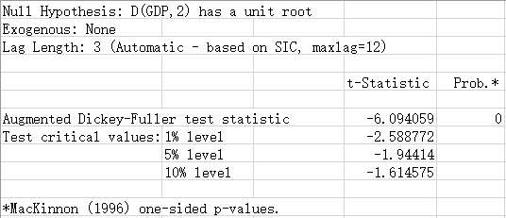
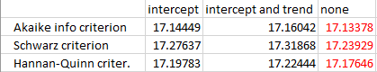
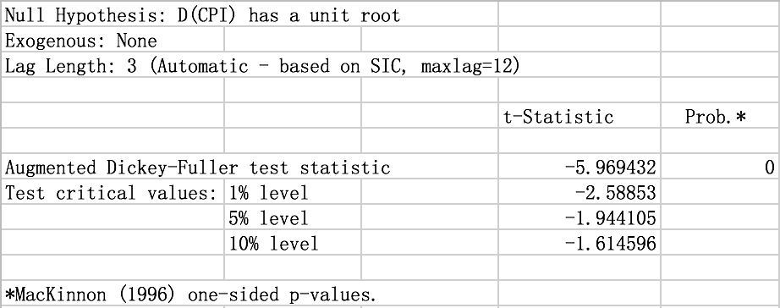
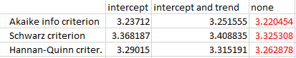
Unit root test
Part Three
Result
Test for GDP
All the three situation of 2nd difference satisfies the requirement.
Test for CPI
All the three situation of 1st difference satisfies the requirement.
Notes:
Looking at the result of different variable. For gdp, the stable status of data is 2 difference because …
As for the result of cpi, …

Slide 19
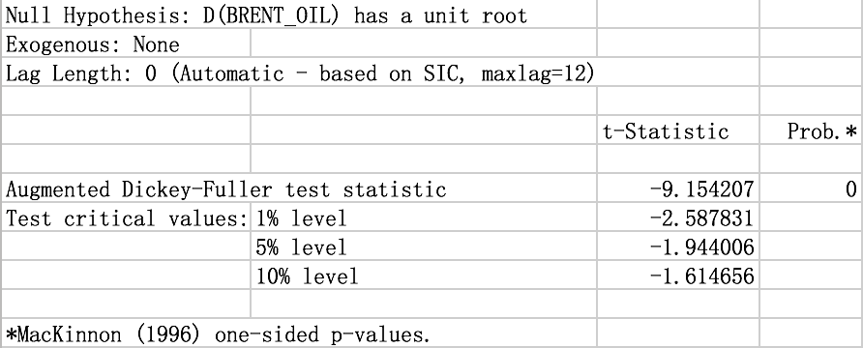
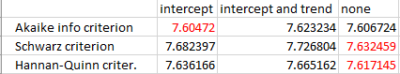
Unit root test
Part Three
Result
Test for Brent
All the three situation of 1st difference satisfies the requirement
As all the three variables are verified stable, the adjusted data will be loaded into the model
Notes:
As for the test for brent, the stable status for brent oil is 1 difference, ….

Slide 20
ARDL model
Part Three
Result
The original data is noted as I(2), I(1) and I(1) and all the three converted to I(0) after difference.
In order to get consistent estimation of t-test of ARDL model, HAC (Newey-West) should be used to get consistent estimation if there exists Heteroscedasticity or Autocorrelation.
The result of lag for three variables are respectively 6, 1 and 0;
The forth lag of GDP, the first lag of CPI and C cannot be used rationally, the other items can be used into the formulas directly.
Notes:
….and …
Looking at the …graph of result,…and …

Slide 21
ARDL model
Part Three
Result
The three criterions named AIC, SC and HQ are small enough that two of them are even lower;
R square and adjusted-R square indicates the independent variables can account for more than 99 percent of the change of dependent variable;
The value of Durbin-Watson statistic is 2.05609 which is nearly equal to 2, suggesting no conditions of Heteroscedasticity.
Notes:
Looking at the graph of estimation graph, … and… and …

Slide 22
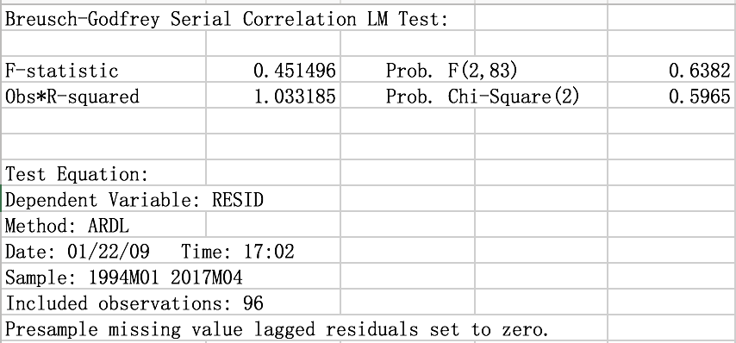
ARDL model
Part Three
Result
Serial correlation LM test
After the estimation of the lag numbers of ARDL model, the serial correlation LM test is used to detect whether there is any serial correlation for residuals;
The F-statistic is about 0.45 and the F-statistic for degree of freedom to 83 and lag times to two is about 3.11. F-value is about 0.64 which shows that the residual has no serial correlation.
Notes:
…as the graph shows,…

Slide 23
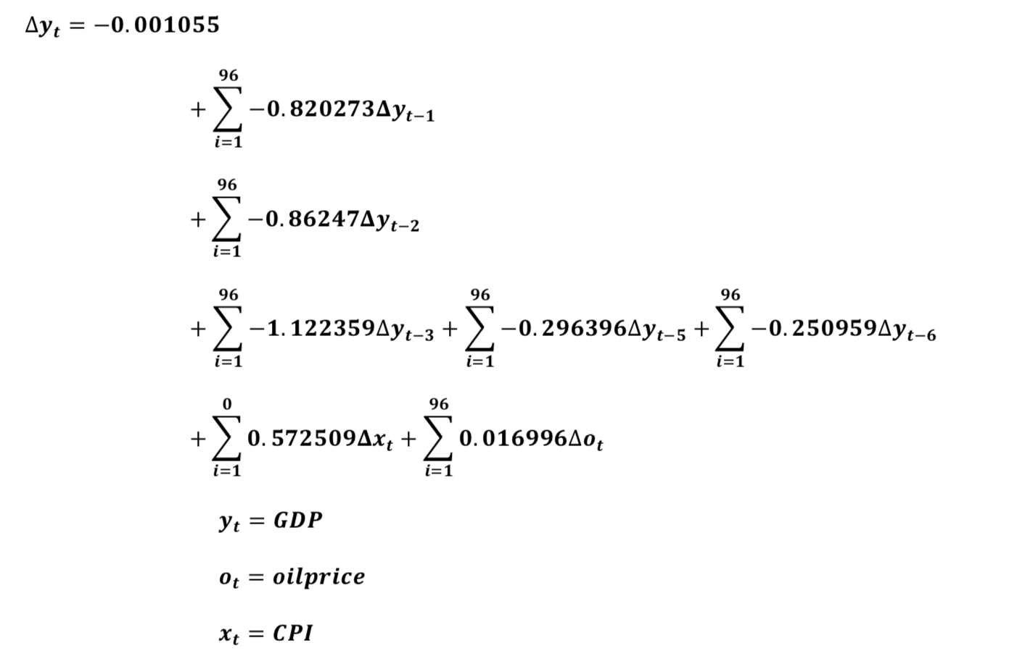
ARDL model
Part Three
Result
From the final formula, the effect can be noticed that the former GDP has a significant negative effect on the change of GDP but the CPI and the oil price have a small positive effect on the change of GDP.
Notes:
So the final formula is showed as this …

Slide 24
Implication
Part Three
Result
the coefficients of the differences between changes in GDP are only significant in the first to third time-lags, while the fourth time-lag seems not significant from the data, disagreed by the expectation
ARDL model consider GDP as one of the independent variables by the way of time lag effect;
Historical data of GDP plays an important role in shifting the growth rate direction;
Results from the Five-Year Plans
Coefficients
(first four time-lags) back up the
government interference
stable and steerable vibration
sustained economic growth
(4th one) changing trends in GDP are supposed to be small because of seasonal pattern and not to be firm because of economic fluctuation
R-square & Adjusted R-square

Slide 25
Implication
Part Three
Result
Oil time-lag effect
1. Accumulated effect of all the time-lags of oil price can explain the 1.6% of the difference;
2. The time-lags indicates the price & cost effect will not deliver the influence on the current production cost;
3. The change rate of oil price may affect the future change rate of GDP by means of influencing the expectation of the economic growth in the domestic market.
CPI time-lag effect
CPI has one time-lag effect (one quarter). Because CPI data is collected monthly, on which the fiscal policy and price regulation launched are based
Article written by Chen (2009) also suggests that there is long-term stable equilibrium relationship between the economic growth and the inflation of prices.

Slide 26
4
CONCLUSION
Summary
Comment

Slide 27
Summary
Part Four
Conclusion
This paper investigates the impact of international crude oil price on China economy, while also tests the influences from CPI and the effect of time lag between current GDP and its historical data
Instant seasonal impact on GDP from oil prices and from CPI, while the past GDP contribute considerable effect on the current GDP in six time-lags
There are always time lags between current GDP with historical CPI data and historical crude oil prices respectively in the model
The continuous growth in CPI and Oil Price will boost the future growth in GDP

Slide 28
Comment
Part Four
Conclusion
Significant influence from CPI and seasonal changing trends in historical GDP growth, suggesting there are instant effect and time-lag effect respectively. Such results from the significant coefficients provide evidence pointing toward governmental regulation on macroeconomy and interference in the production patterns.

Slide 29
5
REFERENCES

Slide 30
Part Five
References
Abeysinghe, T. (2001). Estimation of direct and indirect impact of oil price on growth. Economics Letters, pp. 147-153.
Balcilar, M., Uwlingiye, J., & Gupta, R. (2017, 1). Dynamic relationship between oil price and inflations in South Africa. The Journal of Developing Areas, pp. 73-93.
Baumeister, C., & Kilian, L. (2016, 9). Low oil prices and the U.S. economy: Is this time different? Brookings Papers on Economic Activity, pp. 287-357.
Brune, N. E. (2015, 11). The impact of the U.S. shale boom in Africa. Journal of International Affairs, pp. 101-120.
Du, L., He, Y., & Wei, C. (2010, 4 13). The relationship between oil price shocks and China's macro-economy: An empirical analysis. Energy Policy, pp. 4142-4151.
Hamilton, J. D. (2000, 6). What is an oil shock. NBER Working Paper, p. E3.
Hong, L., Zhou, N., Fridley, D., & Raczko, C. (2013, 11 15). Assessment of China's renewable energy contribution during the 12th Five Year Plan. Energy Policy, pp. 1533-1543.
Huang, H. (2017, 8 1). International curde oil are fluctuating and declining. Economic Daily, p. 12.
Jbir, R., & Zouari-Ghorbel, S. (2008, 12 24). Recent oil price shck and Tunisian economy. Energy Policy, pp. 1041-1051.
Ji, Q., Liu, B., & Zhao, W. (2017, 2 6). International crude oil market trend analysis and price forecast in 2017. Strategy & Policy Decision Research of Chinese Academy of Sciences, pp. 196-201.
Kang, W. (2011). Three essays on the effects of oil prices on state economies. Murfreesboro: Middle Tennessee State University.
Leung, G. C., Li, R., & Walls, W. D. (2012, 9). Transitions in the Chinese market for refined petroleum products. OPEC Energy Review, pp. 349-373.
Liu, Z., Meng, Q., Dong, Q., Zhu, J., Guo, W., Ye, S., . . . Jia, J. (2017, 1). Characteristics and resource potential of oil shale in China. Oil Shale, pp. 15-41.
Lorde, T., Jackman, M., & Thomas, C. (2009, 4 3). The macroeconomic effects of oil price fluctuations on a small open oil-producing country: The case of Trinidad and Tobago. Energy Policy, pp. 2708-2716.
Mohanty, S. K., Akhigbe, A., Al-Khysal, T. A., & Bugshan, T. (2012, 8 29). Oil and stock market activity when prices go up and down: The case of the oil and gas industry. Review Quantitative Finance and Accounting, pp. 253-272.
Omojolaibi, J. A. (2014, 9). Crude oil price dynamics and transmission mechanism of the macroeconomic indicators in Nigeia. OPEC Energy Review, pp. 341-355.
Rafiq, S., Salim, R., & Bloch, H. (2008, 9 11). Impact of crude oil price volatility on economic activities: An empirical investigation in the Thai economy. Resources Policy, pp. 121-132.
Taghizadeh-Hesary, F., Yoshino, N., Mohammadi Hossein Abadi, M., & Farboundmanesh, R. (2016, 2 1). Response of macro variables of emerging and developed oil importers to oil price movements. Journal of the Asia Pacific Economy, pp. 91-102.
Zaouali, S. (2007, 9 1). Impact of higher oil prices on the Chinese economy. OPEC Review, pp. 191-214.
陈,希.(2009,25).CPI与GDP、M2的关系(The Relationship between CPI and GDP and M2). Economic Research Guide, pp. 52-53.
李,慧.(2015).基于独立成分分析的国际原油价格分析预测研究[Predictive analysis and investigation on international crude oil price based on independent component analysis]. Nanjing: Nanjing University of Aeronautics and Astronautics.
李,卓.,&李,林.(2011,515).国际原油价格波动对中国宏观经济影响的重新考察[Reexamination on the fluctuation influence of international crude oil price on Chinese marco economy]. Economic Review, pp. 77-87.
刘,刚.(2008).国际石油价格波动对我国宏观经济影响的计量分析[Quantitative analysis on the influence of the fluctuation in international oil prices to domestic macro economy]. Changchun: Jilin University.
刘,建.,&蒋,殿.(2009,10).国际原油价格冲击对我国经济的影响——基于结构VAR模型的经验分析[The influence on domestic economy from international crude oil price shock: Empirical analysis based on SVAR model]. World Economic Research, pp. 33-38&67.
赵,丹.(2015).国际原油价格冲击下我国经济波动及货币政策规则选择[Domestic economic fluctuation and the choice of monetary policies under the international crude oil price shock]. Beijing: University of International Business and Economics.

Slide 31
THANK YOU!

